Slide 1

Jakarta, 5 August 2022

Slide 2
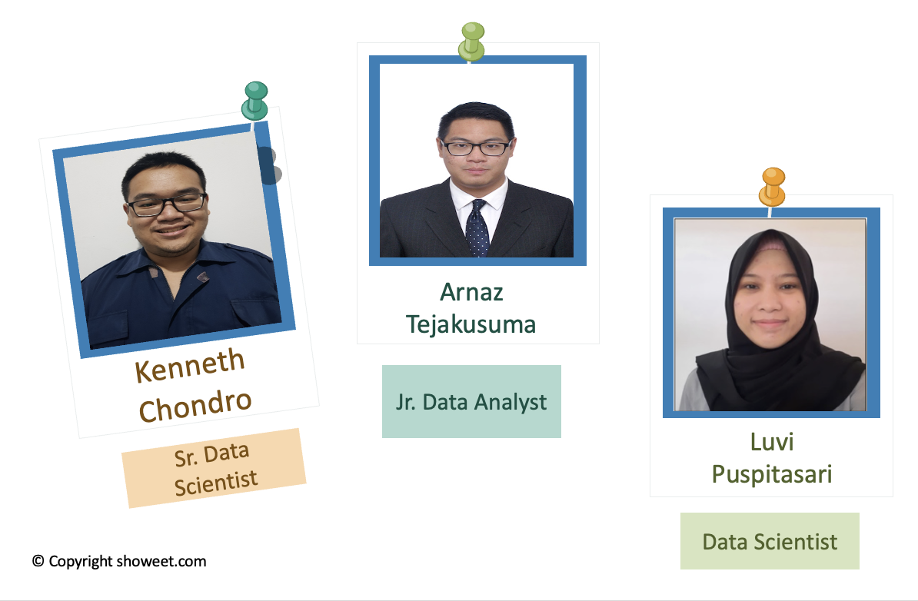
MEET THE TEAM
Notes:
copyright showeet.com

Slide 3


Background
TABLE OF CONTENTS
Project Timeline
Model Architecture, Results, and Demo
Challenges
Success Story
Stretch Goal
Notes:
Source images : Powerpoint Stock Images

Slide 4

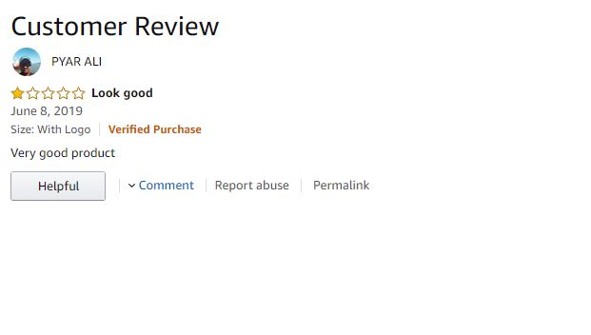

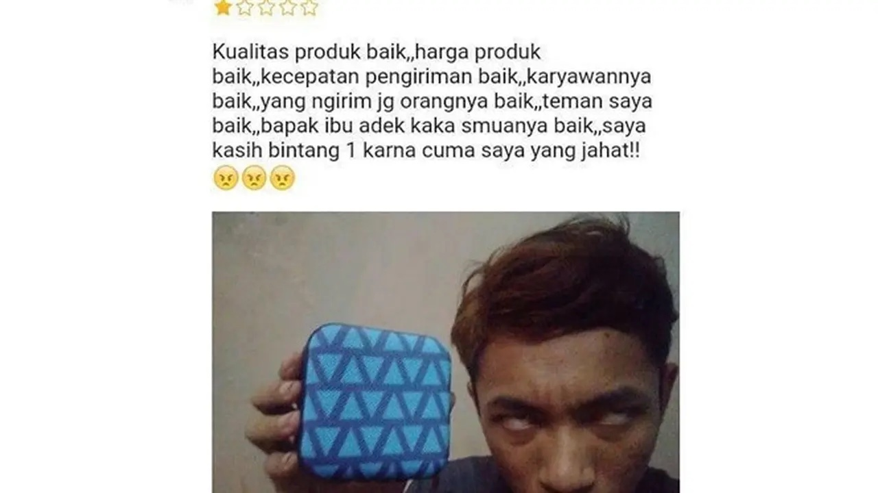
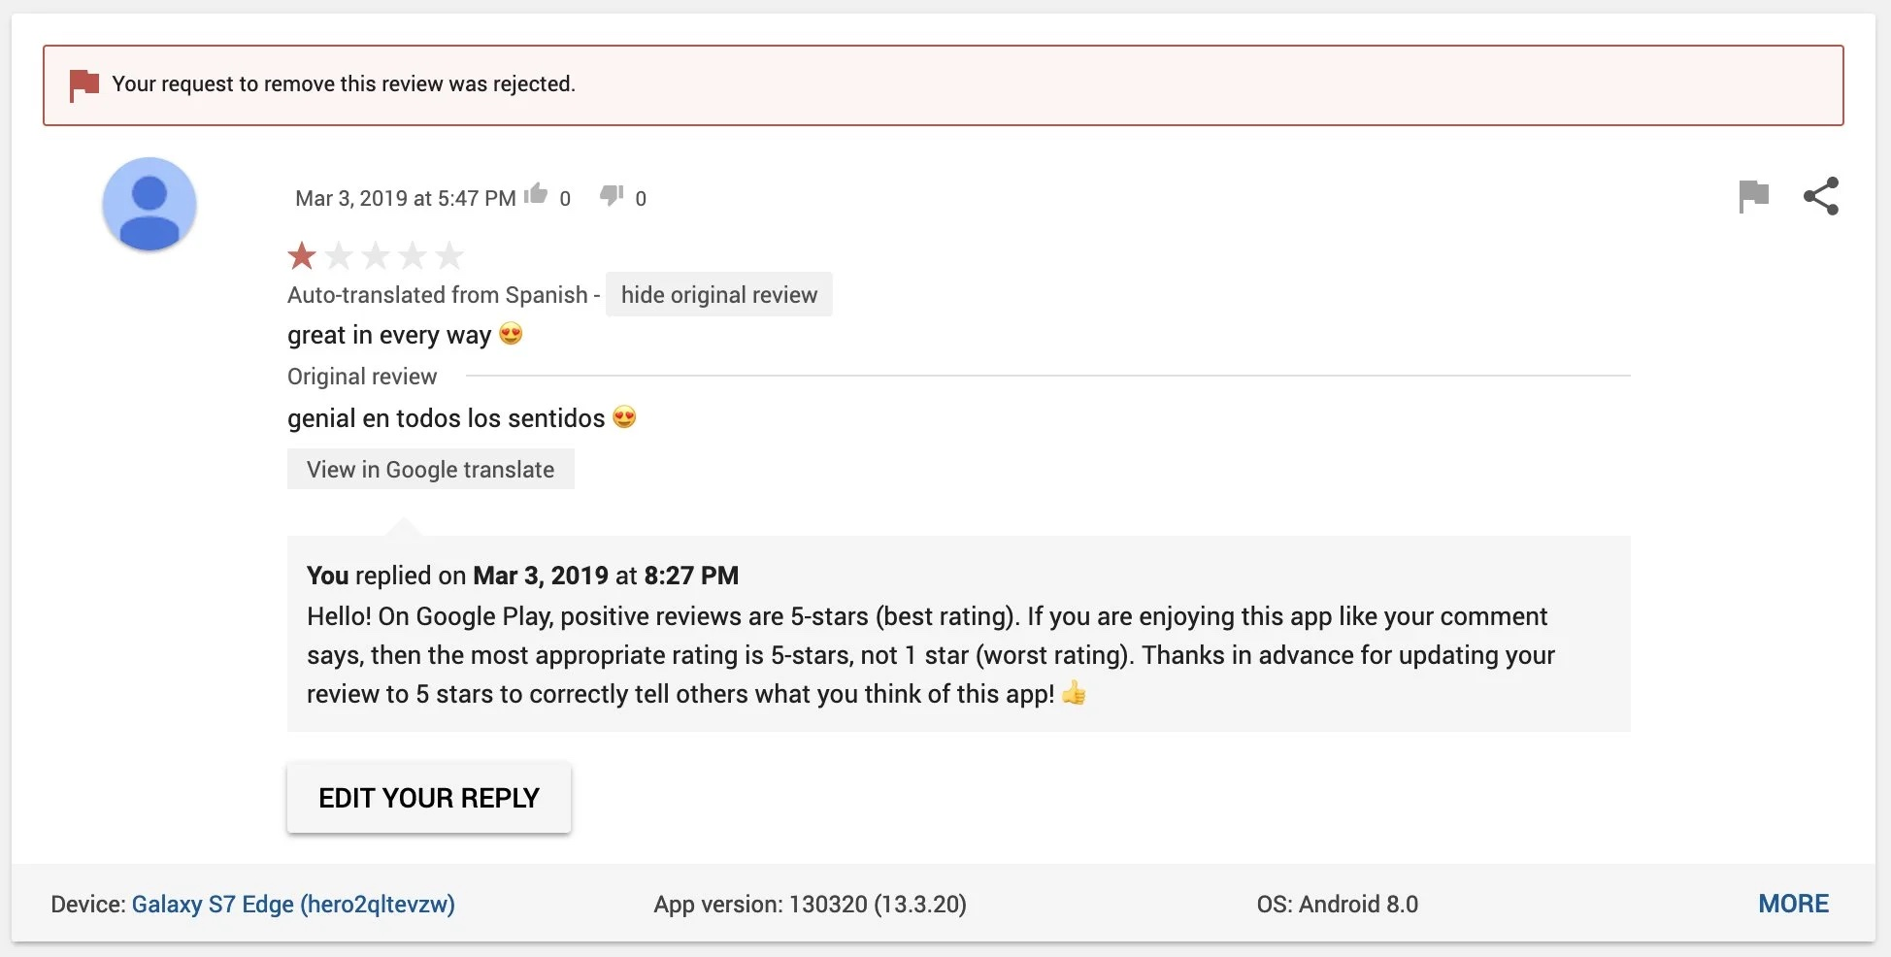
BACKGROUND
e-commerce

Slide 5
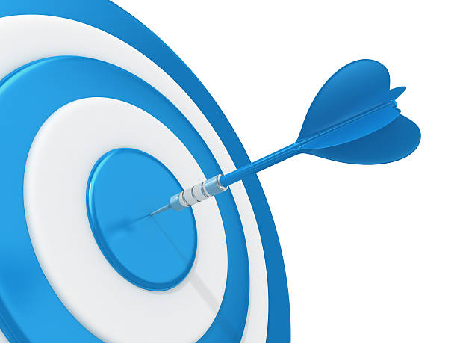
MAIN OBJECTIVES
Give credit where credit is due
Prevent mistakes in user review process

Slide 6
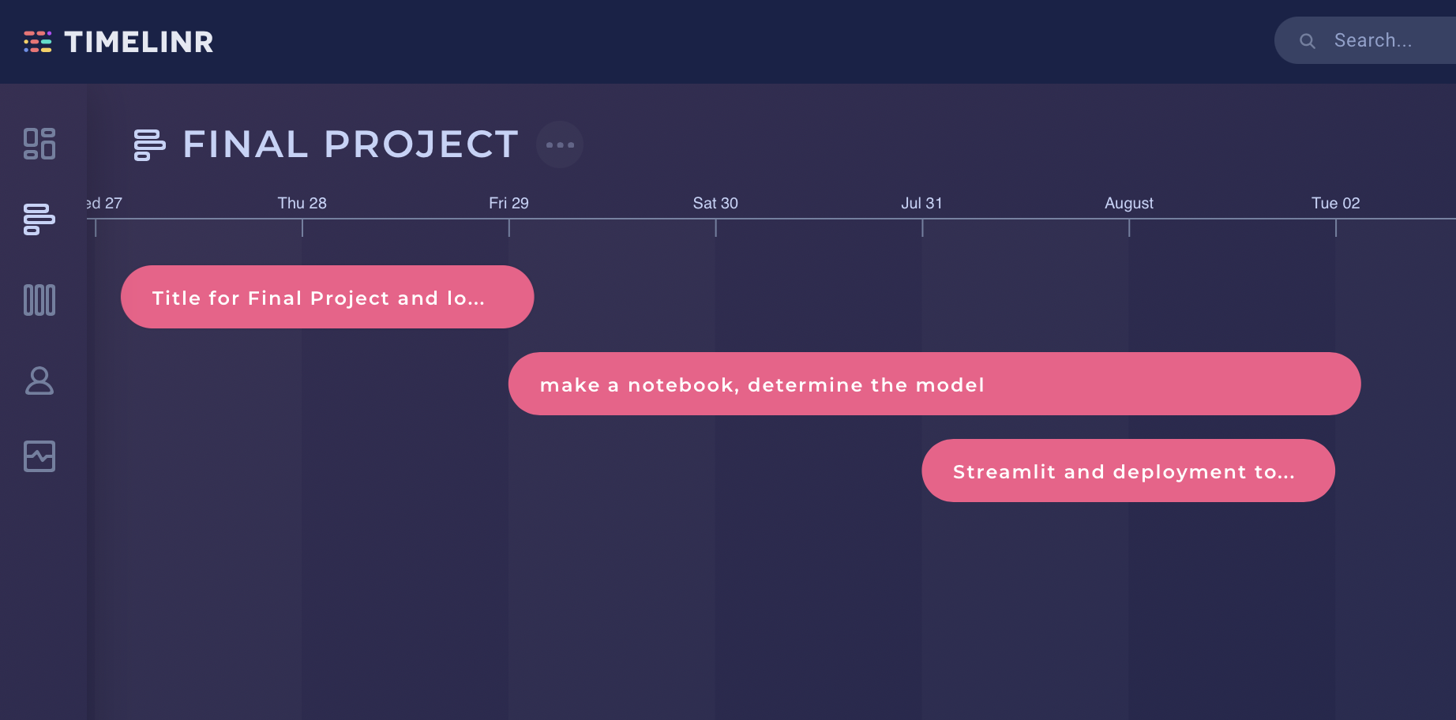
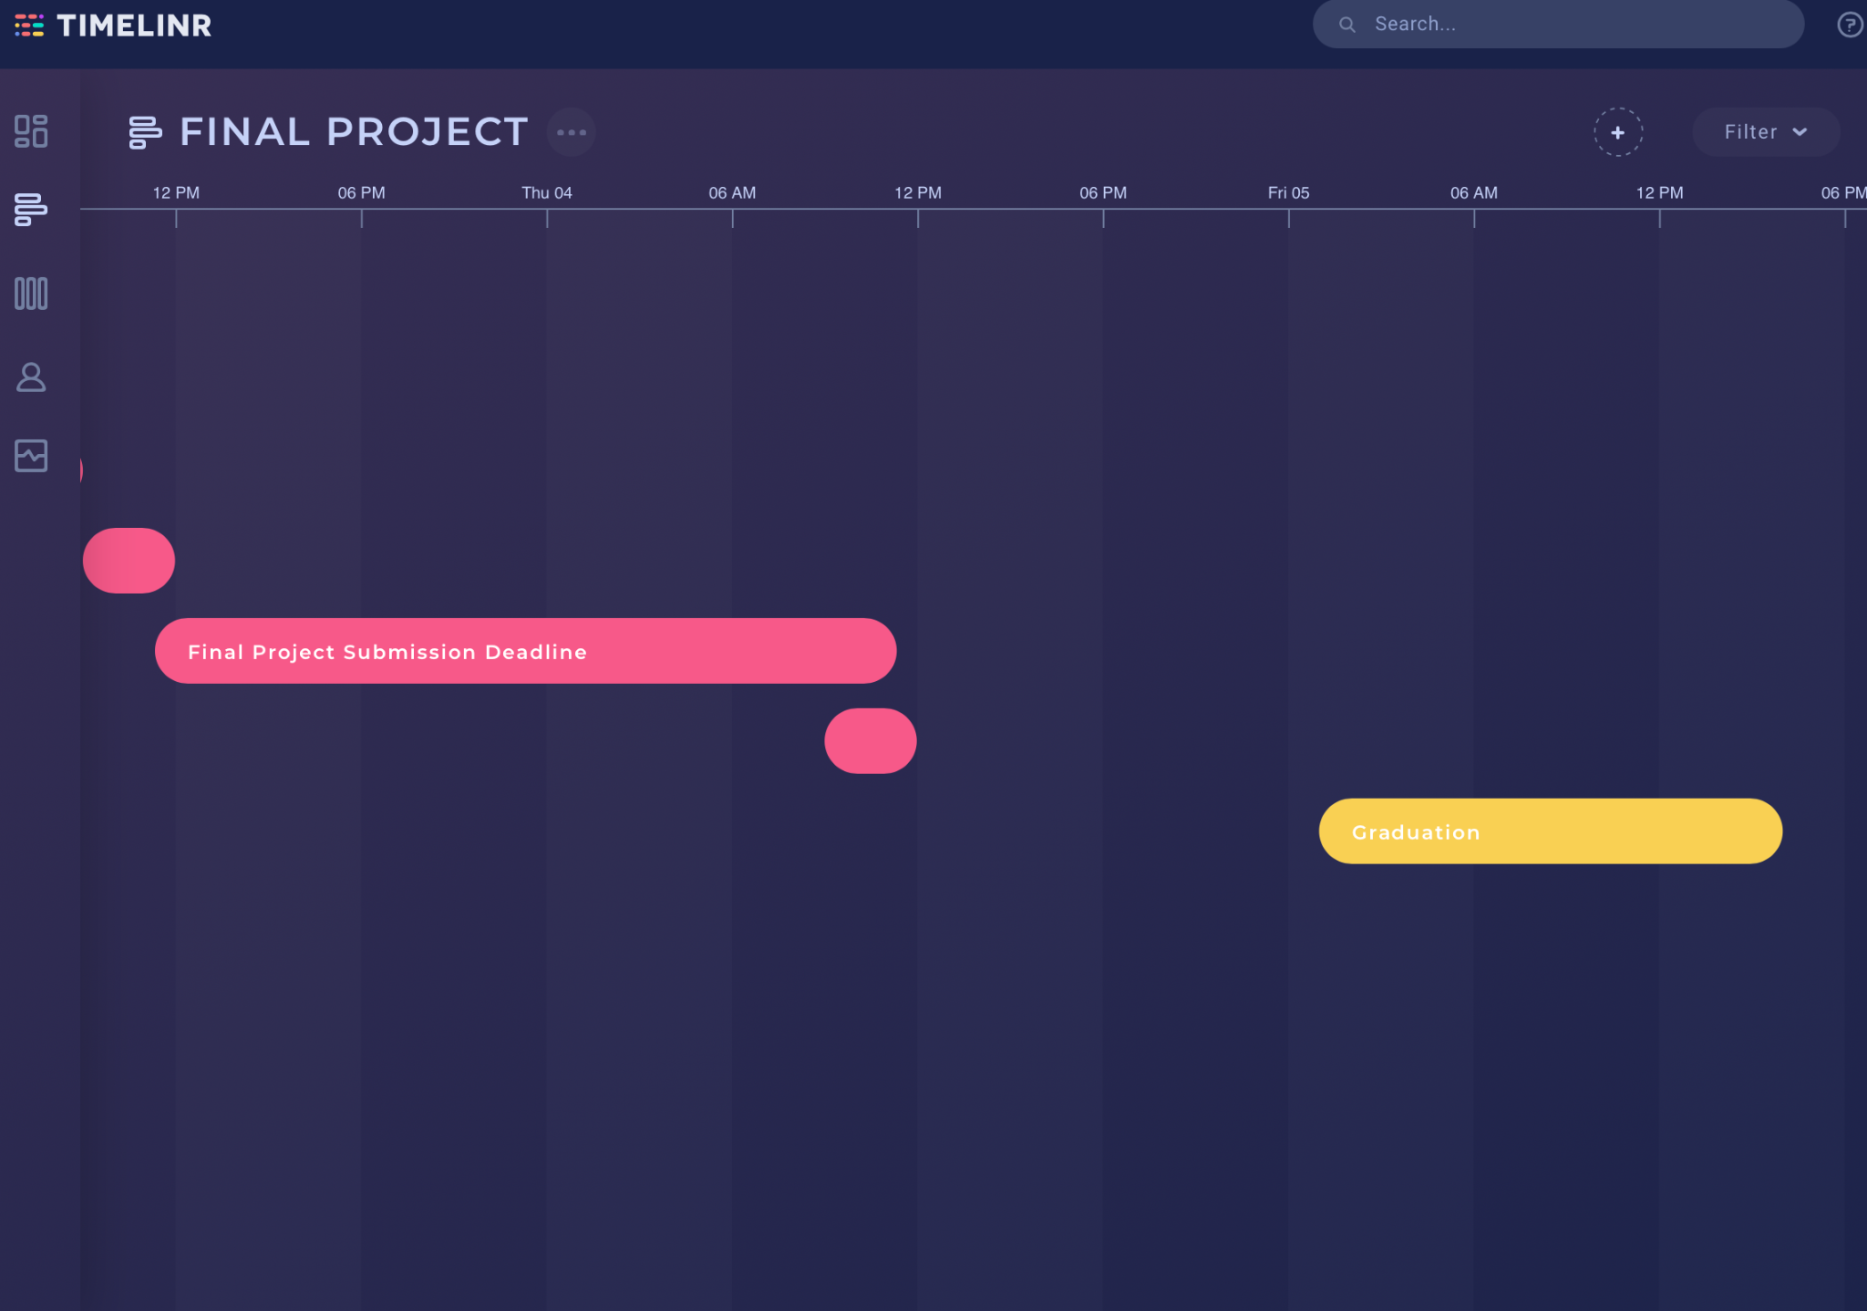
PROJECT TIMELINE
Events :
Choosing dataset: Amazon Customer Reviews
Link:https://www.kaggle.com/datasets/vivekprajapati2048/amazon-customer-reviews
(27-28 Jul)
Final proposal and consultation with instructor (29 Jul)
Drafting notebook, creating models, and deployment (29 Jul - 3 Aug)
Data preprocessing (29 Jul)
Training dataset ( 30 Jul - 2 Aug)
Choosing best model (1 Aug)
Deployment (2 Aug)
Finalization (2 Aug - 3 Aug)
Final project prep and mentoring. Checkpoint : Finalize Project, Slides, and Videos Student
Finalize Drive and Slide Links

Slide 7
MODEL ARCHITECTURE
Embeddingvector features = 300
len(vocab)+1, embedding vector features, txt_length
Dropout = 0.3
Dense = 6
Activation = Softmax
Output Dimension
Model
Embedding
Initialization
Dropout
Batch Normalization
Output
Compile
Sequential
GRU = 420
Default settings
Sparse categorical crossentrophy, Adam, Accuracy

Slide 8
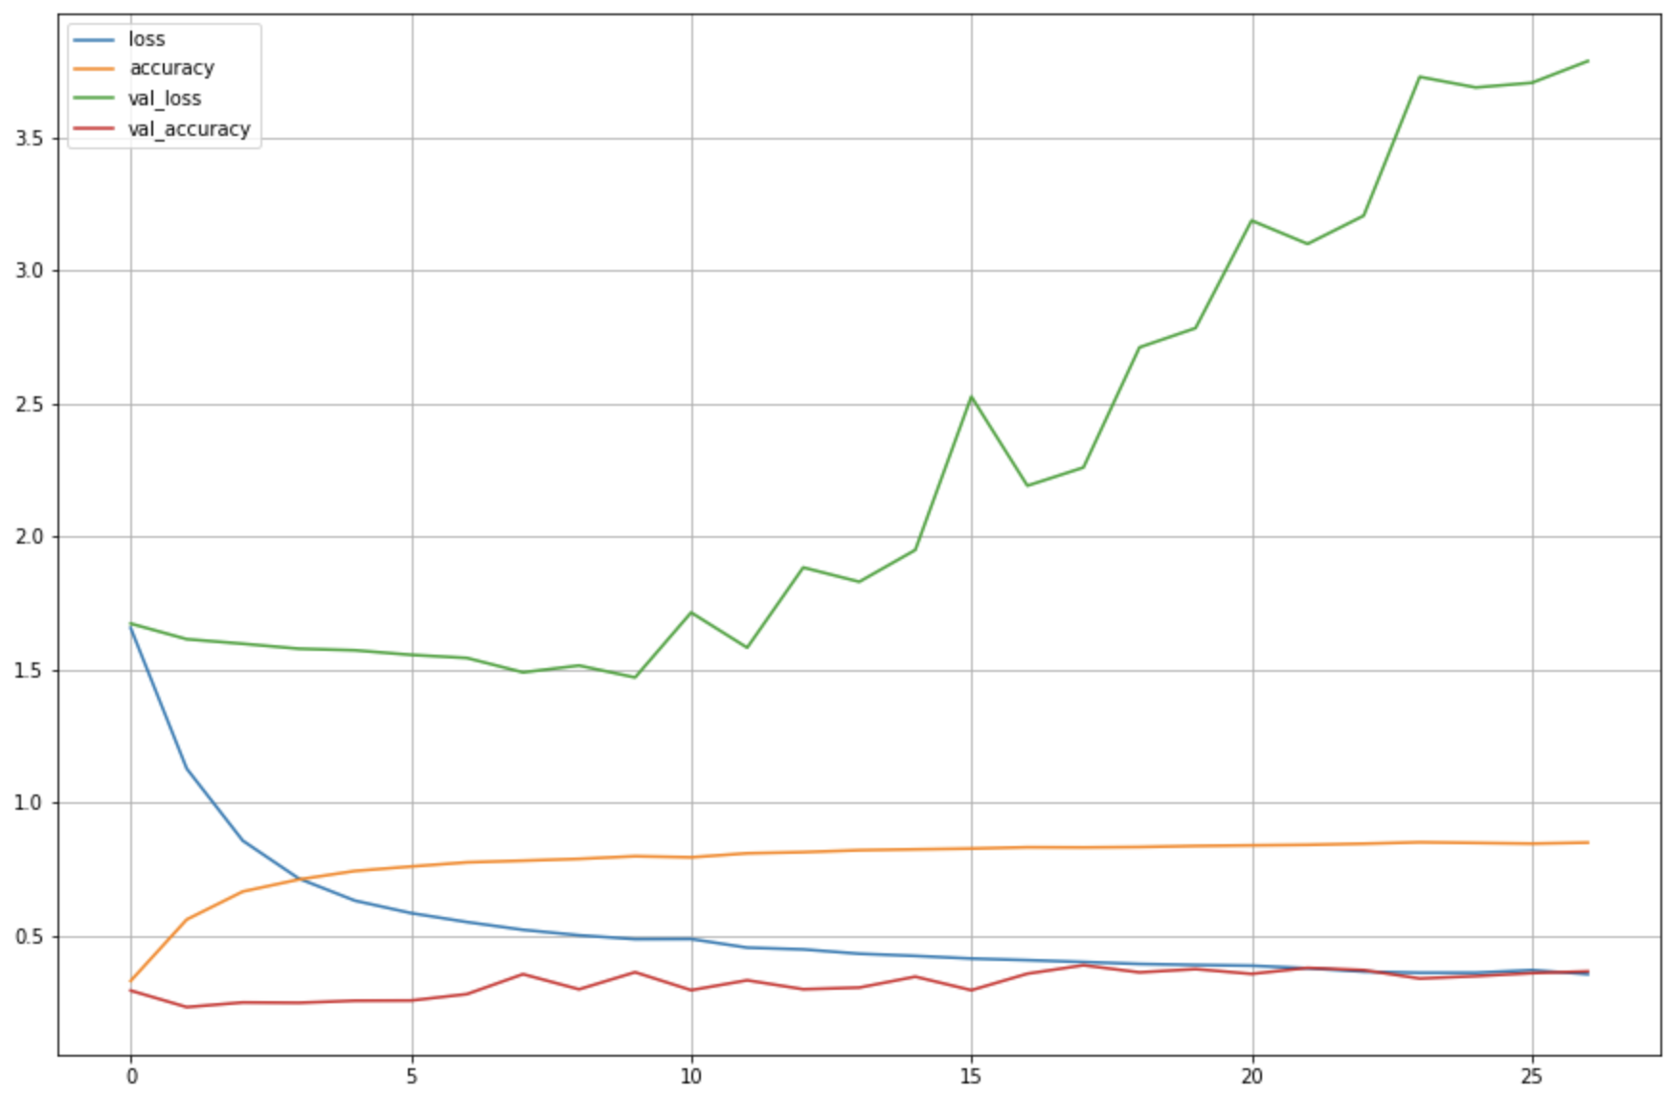
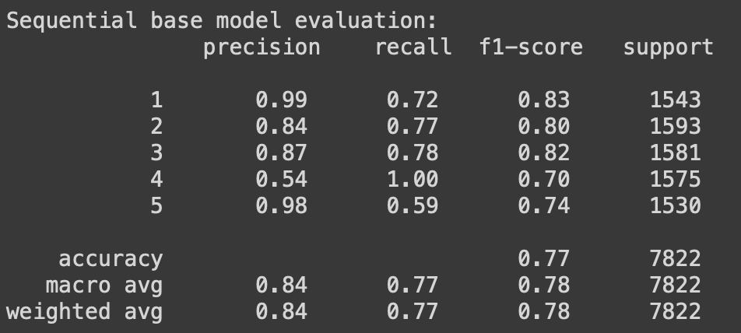
RESULTS
Loss and Accuracy Graphs
Classification Report

Slide 9


DEMO
Try yourself at: auto-rate-comment.herokuapp.com

Slide 10

PROJECT CHALLENGES
Time Constraints
No Local Datasets
1
2
less than 7 days to work on the project
Available datasets are mostly in English
Imbalance Datasets
Deployment Issues
3
4
64% data belong to one class only
Especially when trying to incorporate translator

Slide 11
SUCCESS STORY
Found a model with stable performance
Model has been able to differentiate between positive and negative tone
Prediction results meets expectations, overall this project has been successful!

Slide 12
STRETCH GOALS
Local Context
Implementation of the model
Recreate a model using Indonesian datasets
Incorporate the model into an actual application or platform
Better Model
Incorporate Emoji
Build a model with better stability and performance
Redevelop the model to enable it to recognize emojis

Slide 13
Thank You
For Your Attention!

